Slide 1

Most Streamed Songs of 2024 Project 3
Group 1
Praise Satyagrah, Jeff Riebe, Katharine Bloeser, Bryson Desinor

Slide 2
Agenda
Visualization 1 Top 10 Songs by Platform
Visualization 2
Visualization 3

Slide 3
Case Study- Ethics
Our data came from Kaggle (https://www.kaggle.com/datasets/nelgiriyewithana/most-streamed-spotify-songs-2024) and provided line level data with each line representing a Track or song. This was not user data, rather is aggregate data across users. This reduces ethical concerns about user data that is potentially identifiable. Furthermore, streaming platforms must abide by applicable laws (e.g., the European Union's General Data Protection Regulation and the California Consumer Privacy Act).

Slide 4
Case Study
What’s the number one song so far into 2024?
How do you think song popularity varies by platform?
What platform do you listen to music on?
Reference: https://slate.com/podcasts/hit-parade

Slide 5
Case Study- Top Songs on Streaming Platforms in 2024
We will use a Kaggle dataset, which provides the name of songs (N = 4,370), the artist, and plays by streaming platform (e.g., Spotify, Apple Music). We stored data using PostgreSQL and created the following visualizations using JavaScript.
Visualization 1: Top 10 streaming songs (Bar chart) by platform (dropdown)?
Visualization 2: Top What songs appear most frequently Shazam, and what Is the songs popularity by platform (Bubble Chart, Dropdown menu)?
Visualization 3: Top 5 Songs and where they appear on playlist determined by playlist reach. (Pie Chart)?
References:
https://www.kaggle.com/datasets/nelgiriyewithana/most-streamed-spotify-songs-2024
ChatGPT
StackOverflow
Rutger Bootcamp Office hours

Slide 6
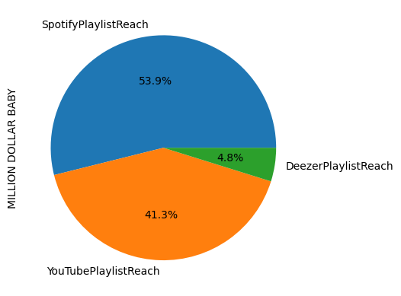

Slide 7
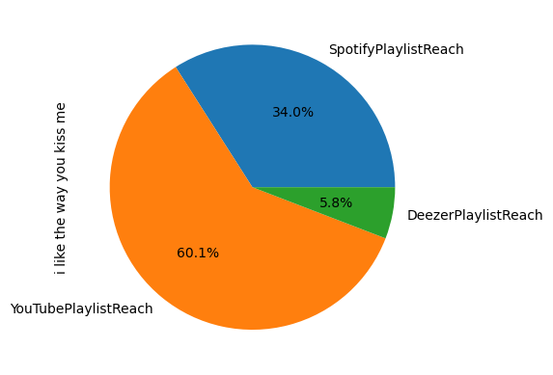

Slide 8
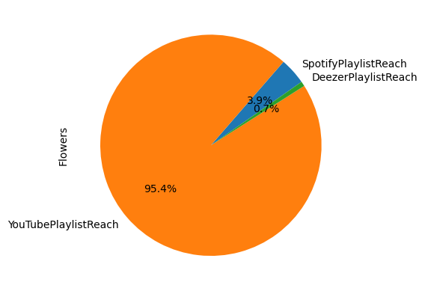

Slide 9
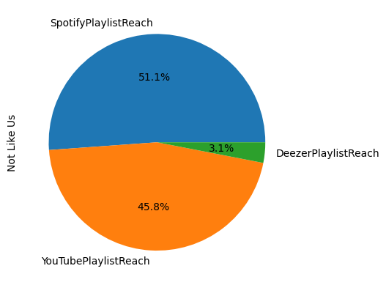

Slide 11
Percentage of streams

